Slide 1
Answers Requestor Training for Customer Engineering
Arine Hillery & Jeffrey D Cooper
Feb 20, 2025
Revision 4
Cummins Internal Use Only
Notes:
Rev 2. Nov 28, 2022

Slide 2
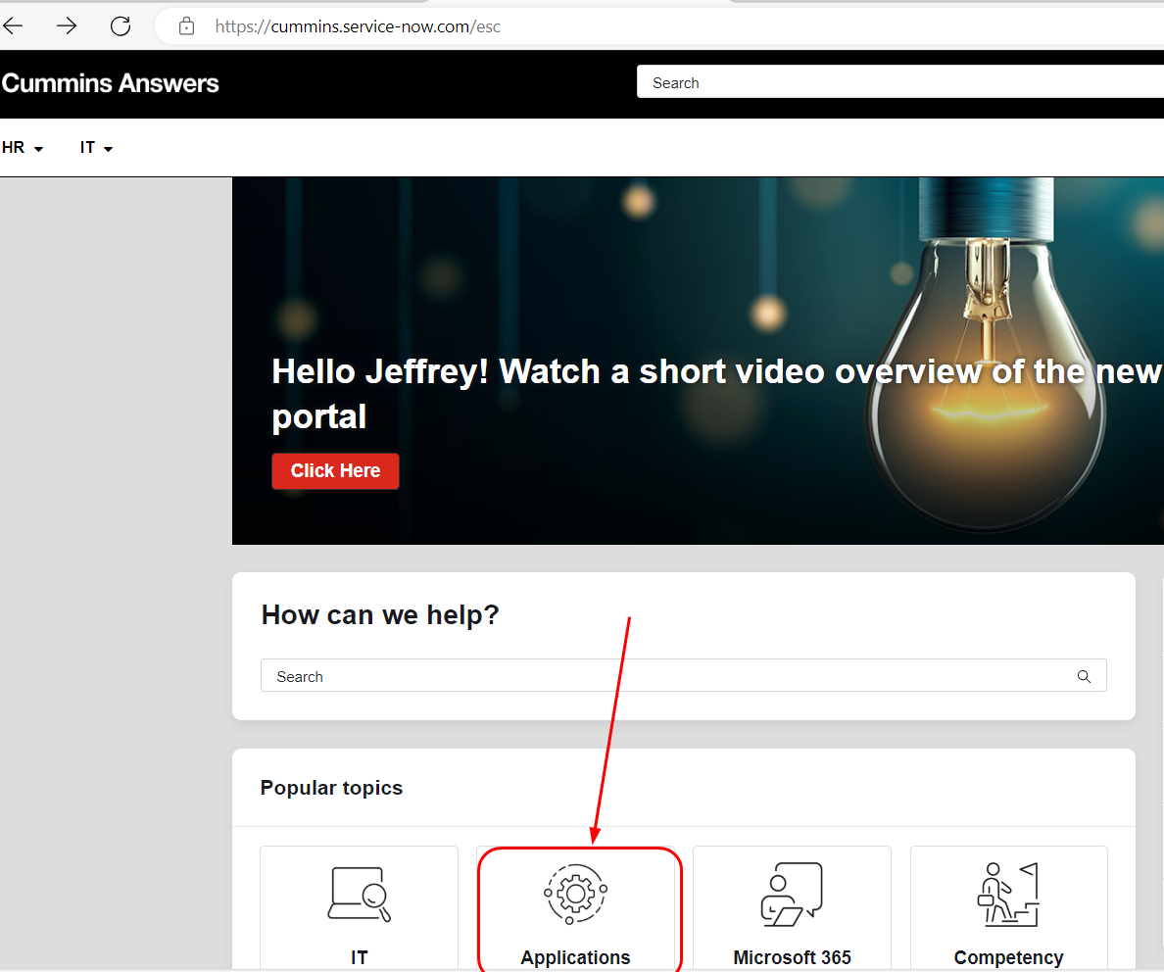
How to access the Answers help system
To create Requests in Answers: answers.cummins.com Homepage - Answers (service-now.com)
Select Applications

Slide 3
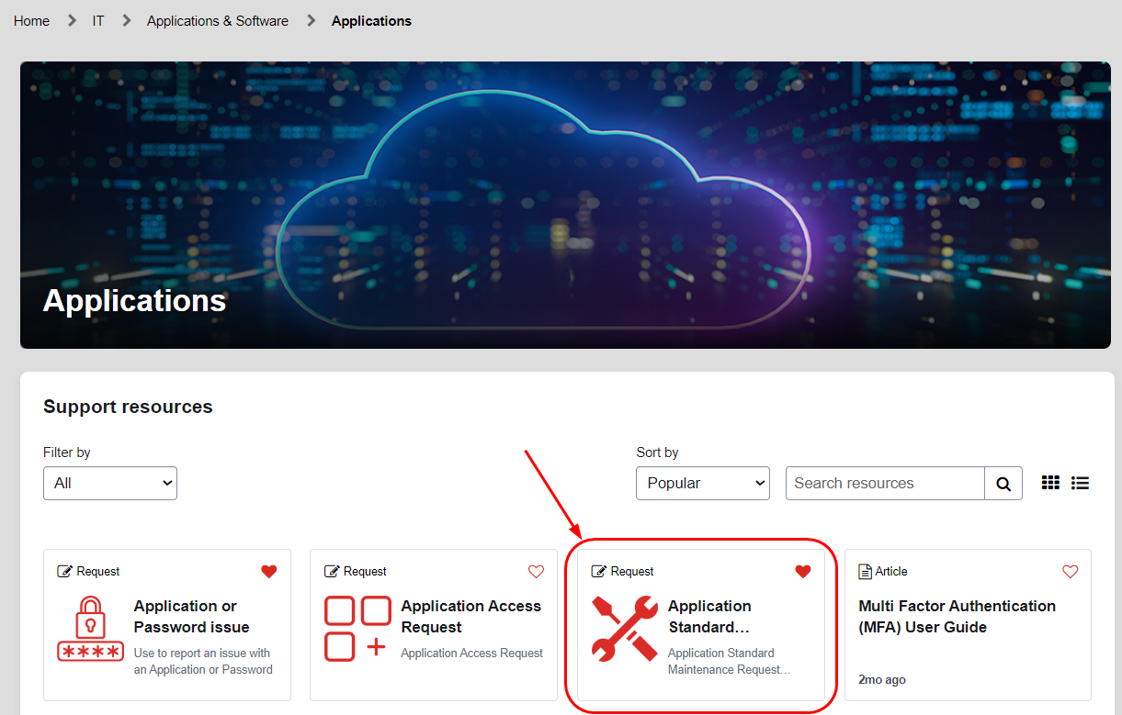
Finding your Catalog Item
To report an issue with a broken application for an IT group, select ‘Application or Password Issue’
To gain access to a particular application, select ‘Application Access Request’
To create a request for a functional support group, select ‘Application Standard Maintenance Request’ (THIS IS THE ONE TO SELECT MOST OF THE TIME)

Slide 4
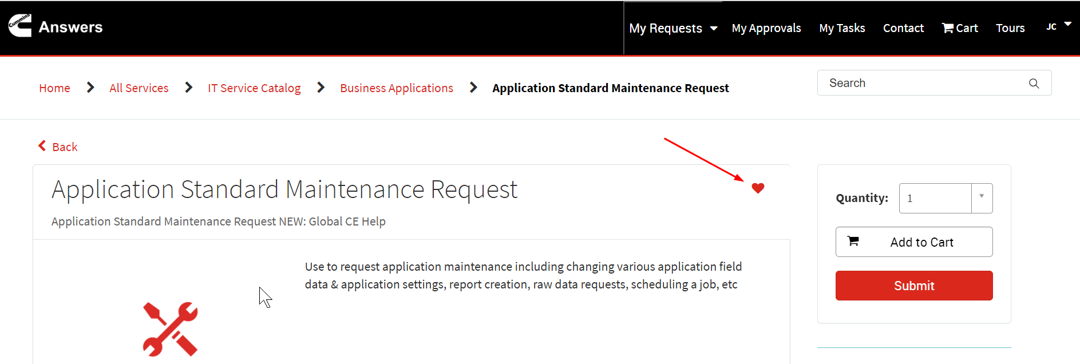
Creating a Favorite Catalog Item
To make it easy to find your catalog item in the future, Click on the ‘Favorite’ Heart icon

Slide 5
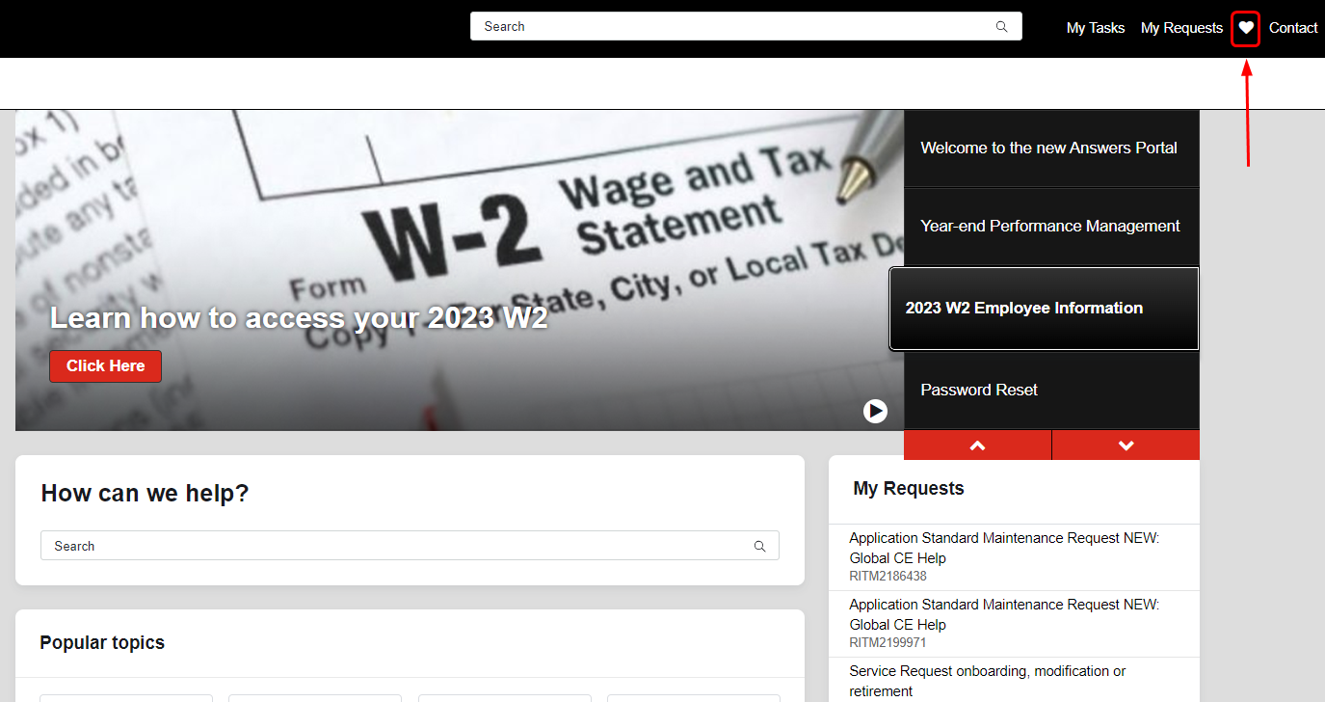
Finding a favorite Catalog Item
If you created a favorite catalog item, from the Home page, click Heart icon and it will take you to your favorites

Slide 6
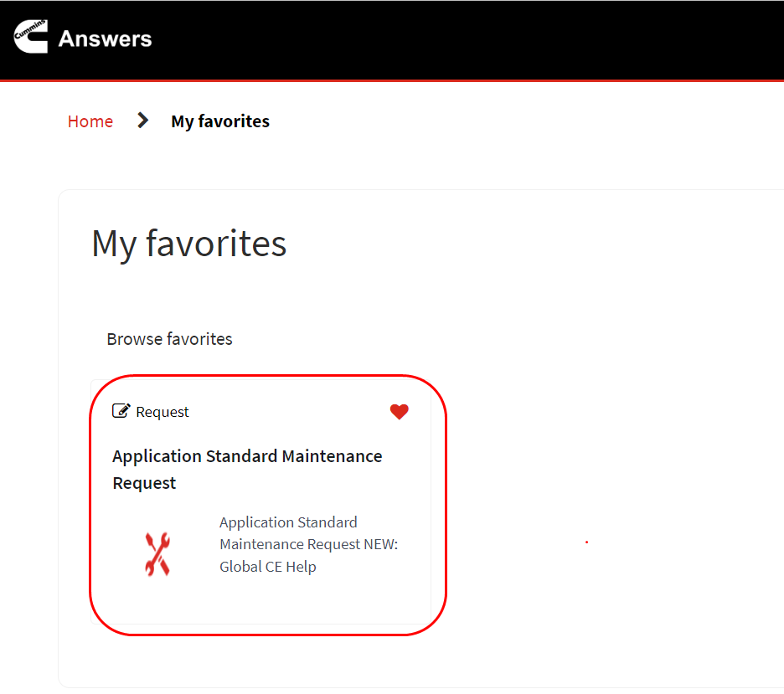
Selecting your Favorite Catalog Item
Select the Catalog Item

Slide 7
Answers routes Requests based on Application
Select the Application
Application | Request Type
COLS | Autospec, Configuration, IQA Check, MCAD, Option, Price Spec, Pricing, Prod ID Request, Training, Transfer Ownership
Cummins Advisor | AIR, Advisor IQA, IQA Record Request, IQA Question/Support, WebDATA,
Calibration and Controls Support | Project Design/Product Documentation, Issue/Bug
Cummins Global Customer Engineering Website(GCE/GCEWeb) | AEB/CEB, Altitude Derate Request, Application Support (Accelera, CES, Defence, EBU, PSBU), Customer Engineering Training, Datasheet, FEAD, GCEWeb (Broken link, page error, create/update webpage, CES update) Normalized Fuel Map request, MAB request and publishing, WW Tech Config)
Applications - Continued on next slide

Slide 8
Answers routes Requests based on Application
Application | Request Type
Electronic Tools: Cummins Calibration Data Management Cummins Update Manager Cummins Connected Vehicle Platform Electronic Tools - Cummins Rules Development Environment G2 Cummins INTACT Cummins CalbertNG Cummins Datalogger Cummins PowerMatch G2 Cummins Metadata Tool Core II Software Tool (C2ST) Cummins VEPS Cummins CTAS/LCT Cummins CALTERM | C2ST, Calbert, Calterm, CMT, CVP, CTAS, Cal Data Mgt, INTACT, Update Manager, Rules Dev, VCP/VEPS, Data Logger, PowerMatch
Applications - Continued on next slide

Slide 9
Answers routes Requests based on Application
Application | Request Type
Engine Genealogy | Option usage, CES for bulk items. CES usage pivot by year
MCAD – Customer Engineering | Drawing request, Modeler request
Power Choice | Power Truck, PSBU MMS, Desktop VMS, ESCAT, MIDAT, ePower Spec
Regulatory and Compliance Application (RCAS) – RER/RAWeb | RA Check, RER

Slide 10
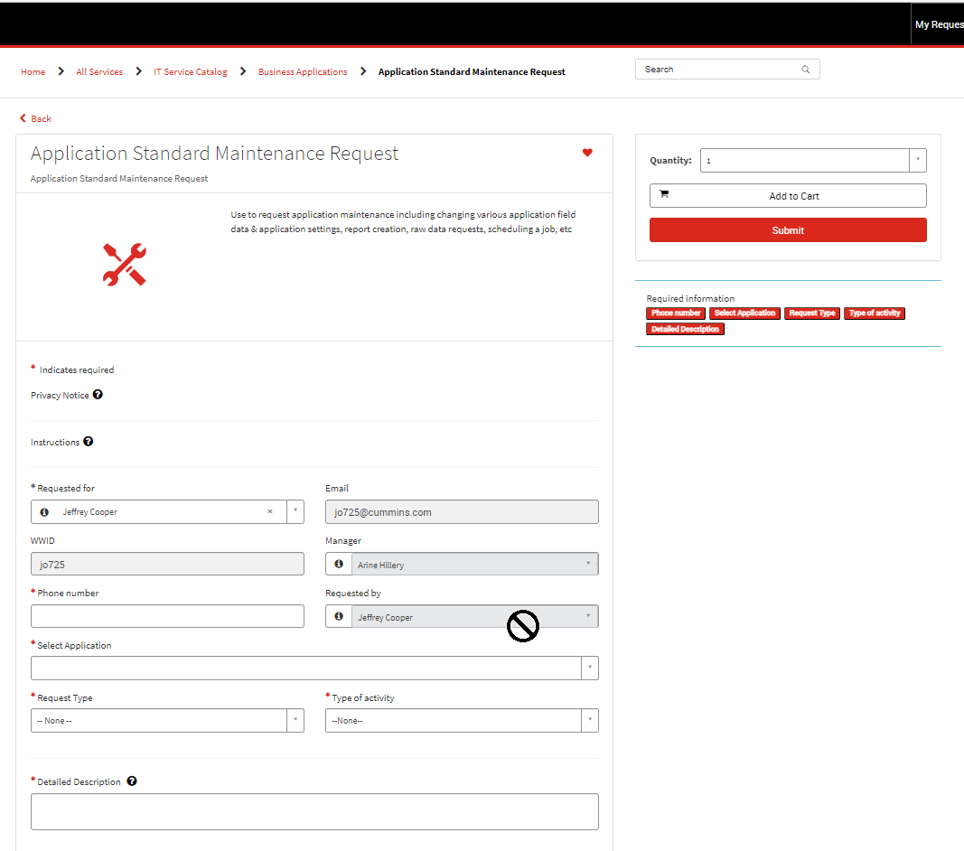
The initial Application Standard Maintenance Request form
You can change who the ticket is requested for by pressing the X at the end of the persons name, and search for a different name or WWID
If your Phone Number does not auto populate, you must enter some value
To have the phone number auto populate, add your number on https://me.cummins.com, and it will populate within 24 hours

Slide 11
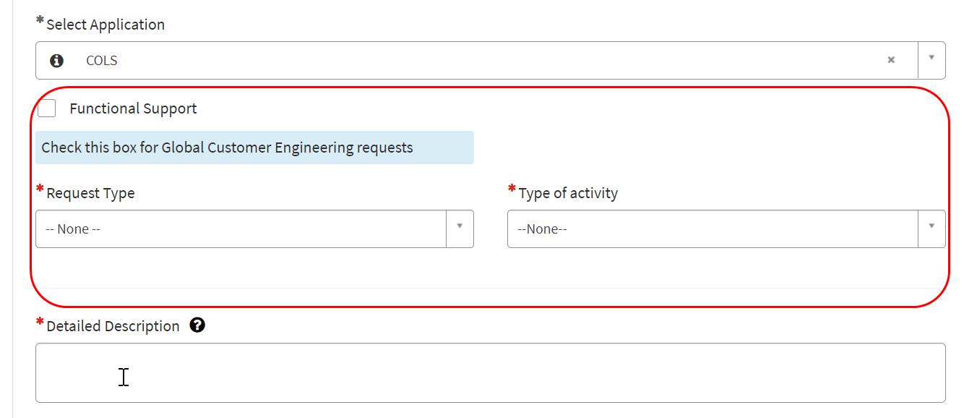
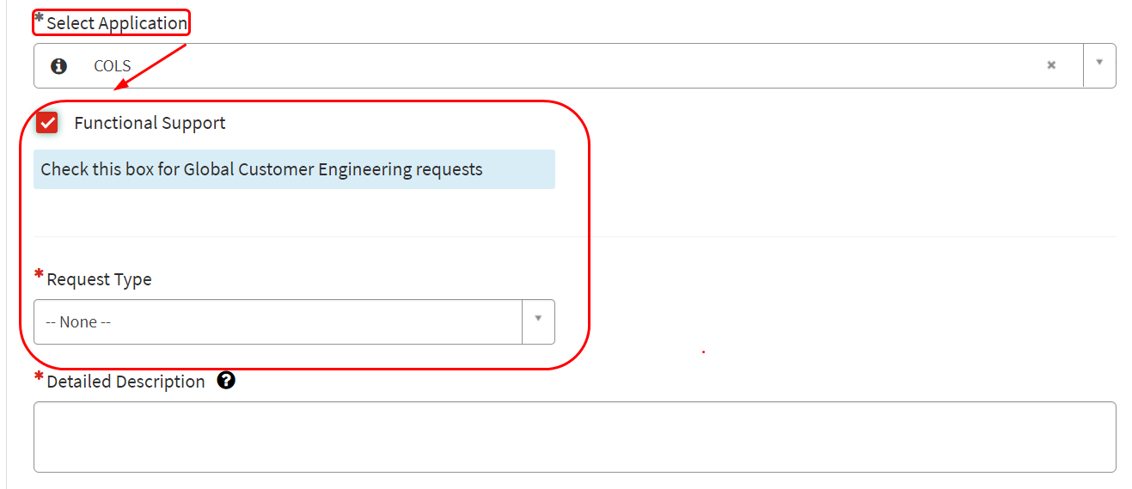
Filling out the Answers Request
Select the Application(for this example: COLS), click on the Functional Support check box under the Application field. Checking this box will hide IT related fields and values, allowing the functional support fields to be displayed.
Before clicking checkbox After clicking checkbox

Slide 12
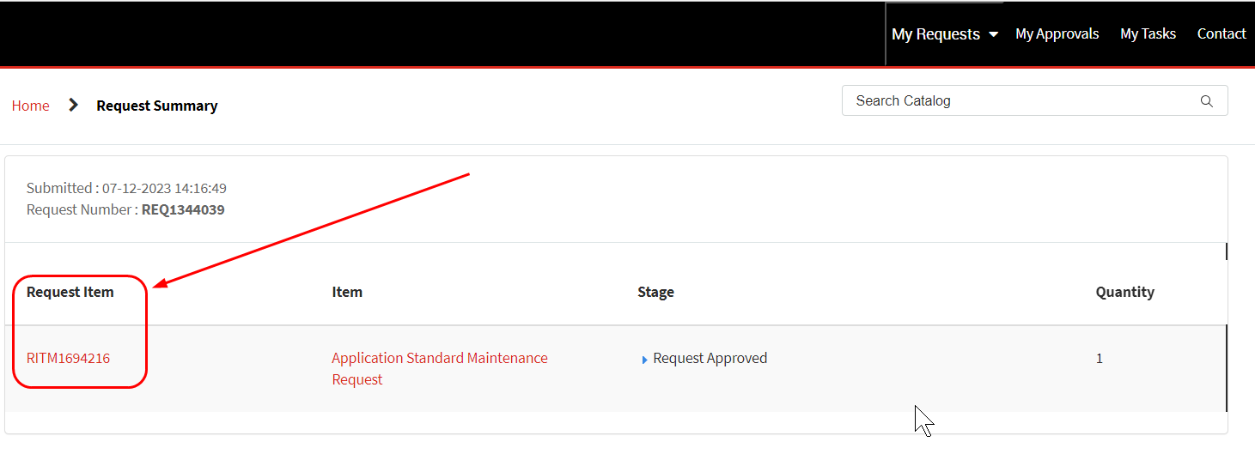
Populate and Submit the Request
Populate the required fields, and add any attachments
Press the Submit button to create the request
An RITM number will be created and displayed on the screen

Slide 13
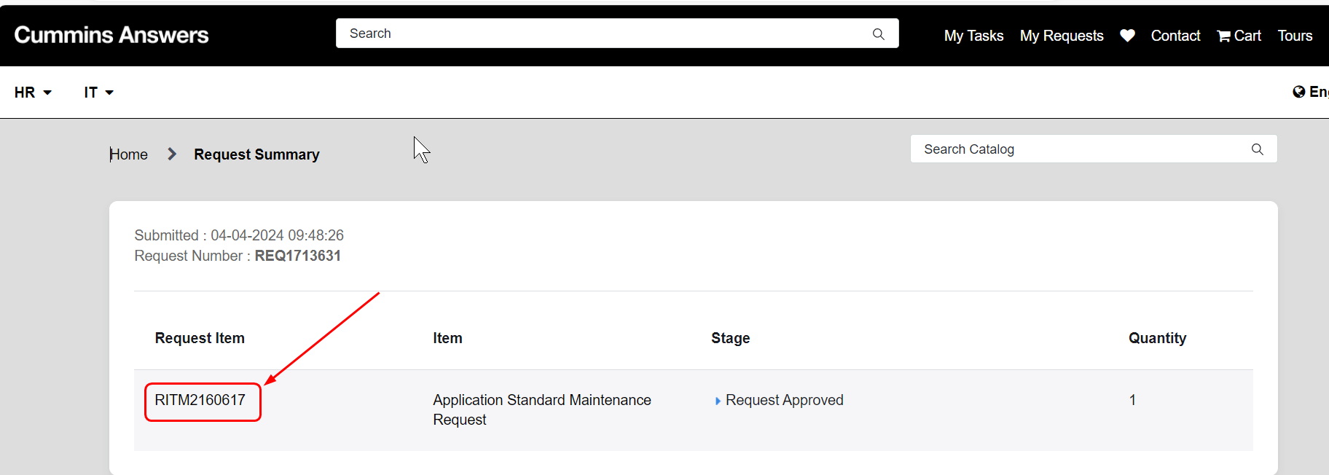
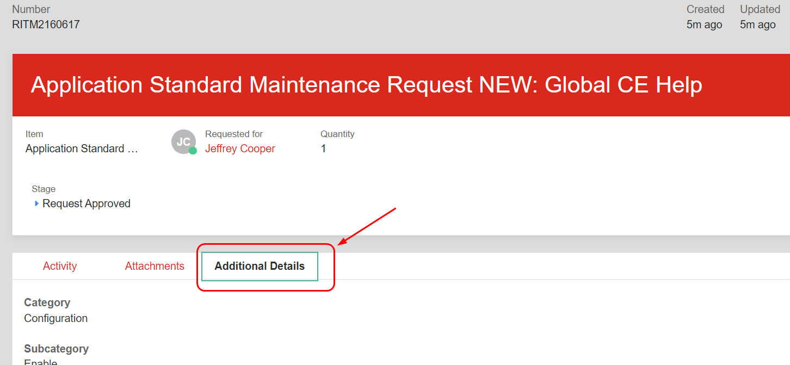
Reviewing the Request after submission
Click the RITM number, then click ‘Additional Details’ to see the data just entered

Slide 14
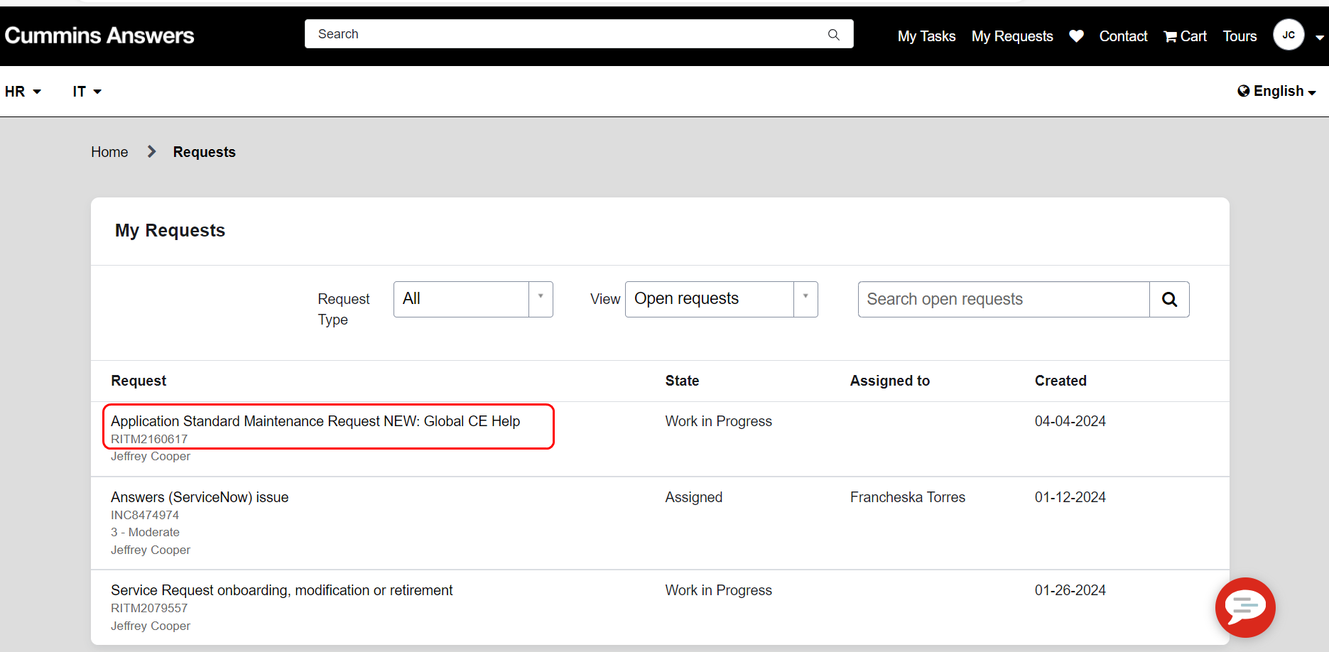
Reviewing all the Requests I’ve Created
From the home page, in the ‘My Requests’ box, click on the request one you want to view
  If it is assigned, it will show who it is assigned to
  To view Closed requests select ‘Closed requests’ from the View field.

Slide 15
Emails
Emails are sent based on the following conditions
Catalog Type | Notification Name | Description | Email sent to
REQ | Request Created | Send the notification when Request is created | Requestor
REQ | Request moved to Pending | Send the notification when Request state changes to Pending | Requestor
REQ | Request Cancelled | Sent when RITM is closed incomplete or closed skipped | Requestor
REQ | Request Completed | Send the notification when Request is Completed | Requestor
SCTASK | Tasks assigned to Fulfiller | When Assigned to is populated or updated | Assigned To
SCTASK | Service Catalog tasks Assigned to | Informing the end user once task is assigned to an agent | Requestor
SCTASK | Task assigned to a Fulfillment group | Informing the group that a task is assigned to them | Assignment group (including manager)
SCTASK | Task moved to Pending Customer Input | Send the notification when Request state changes to pending and pending status reason is Awaiting Customer | Requestor

Slide 16
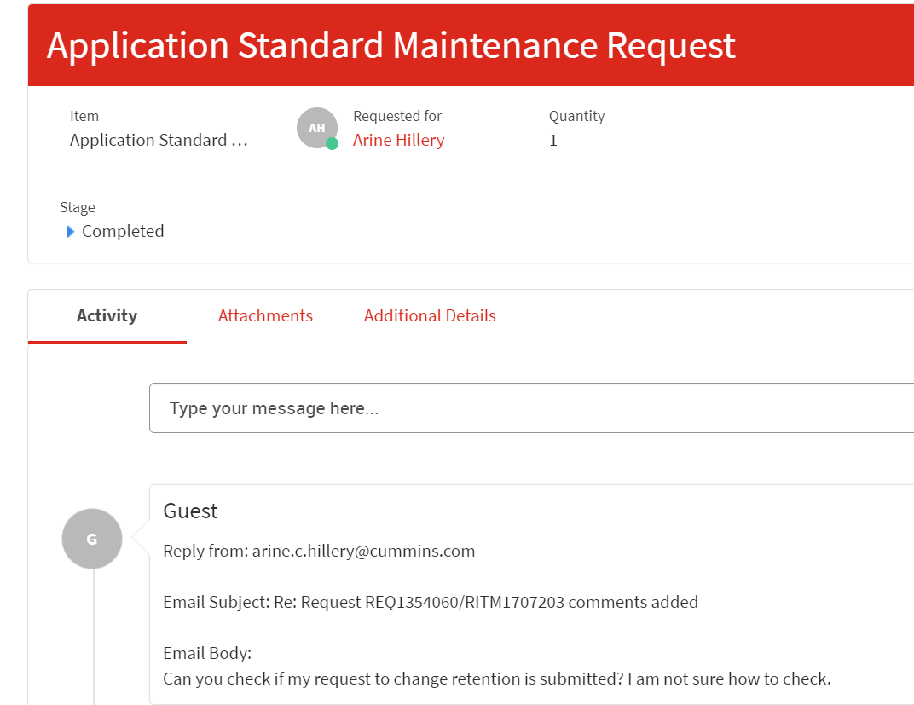
Replying to an Answers Email
You can reply to the automated emails generated by Answers and the comments will be recorded with the request
Below is an example of what the request looks like in Answers after replying from Outlook

Slide 17
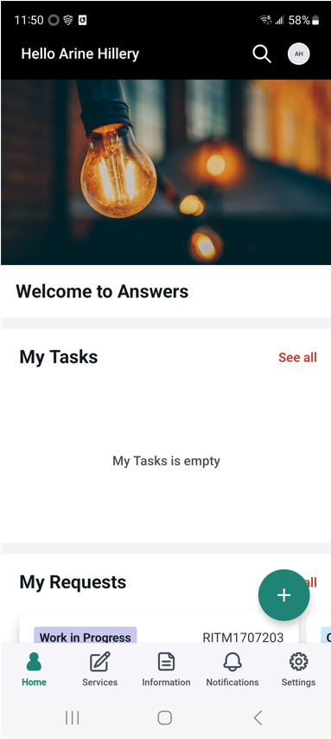
Mobile
Answers can be used on your smart device by downloading ‘Now Mobile’.

Slide 18
End of Presentation

