Slide 1
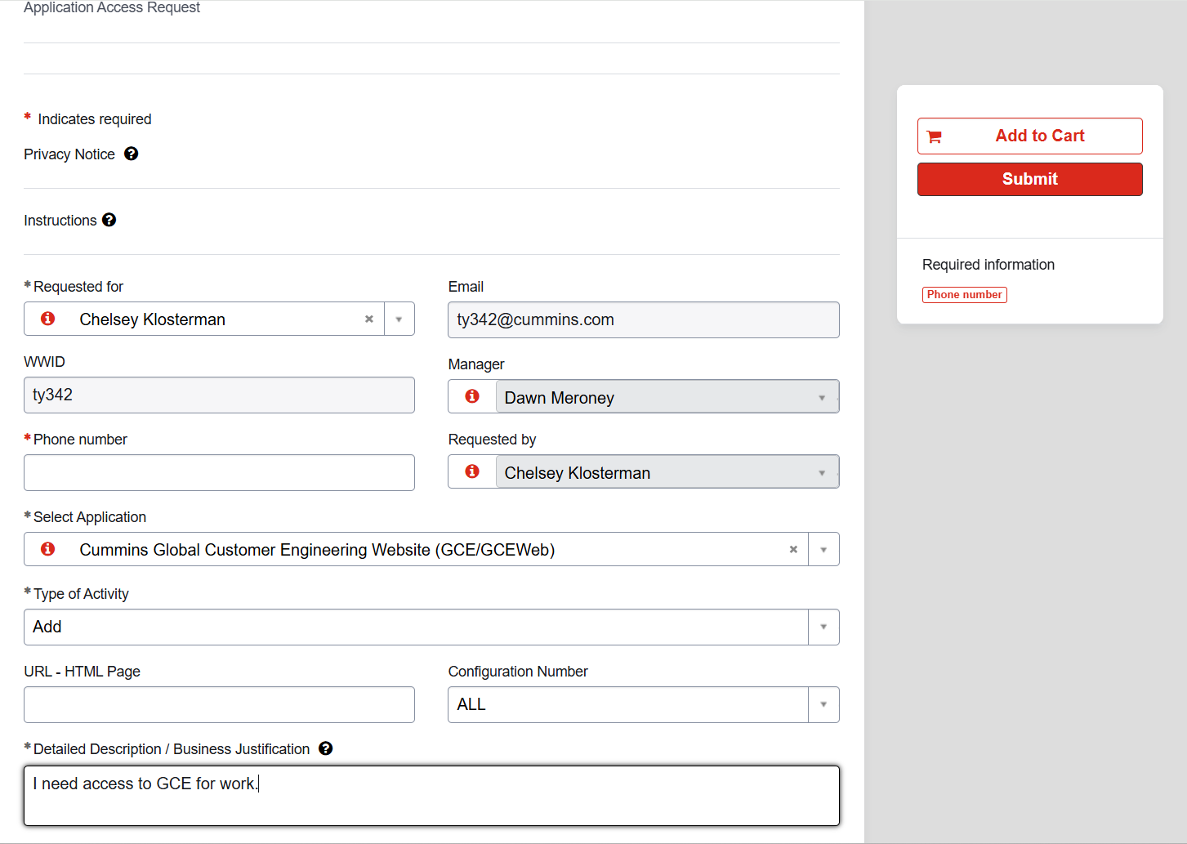



For Application please be sure to select “GCE/GCEWeb”
For “Type of Activity” select “Add”
Cummins employees receive a general access. If you only require general employee access just complete the description box as shown. No other information is needed.
If access to a secured, G-Drive, or OEM page is needed please provide that URL where the blue highlight is.
If you want to be an OEM Sponsor please specify that Sponsor access is needed.

